Slide 1
CAPSTONE PROJECT- BATTLE OF THE NEIGHBORHOODS
City comparison and Restaurant Venue Recommendation

Slide 2
recommended place of New York City:
Populated area like shopping complex, school, college, office is placed, there will restaurant suitable.
Area wise target customer.
Customer wise food variant.
Based on peoples earning define food cost.

Slide 3
DATA ACQUISITION:
New York data set will retrieve from this link https://cocl.us/new_york_dataset .
By using of the FourSquare API (FourSquare website: www.foursquare.com) to explore neighborhoods in selected area.
By usinf of GeoSpace data from https://data.cityofnewyork.us/City-Government/Borough-Boundaries/tqmj-j8zm will get New York Borough boundaries that will help us visualize choropleth map.

Slide 4
Approach:
Collect the New York City data from https://cocl.us/new_york_dataset
Using FourSquare API, we will find all venues for each neighborhood.
Find out all venues for restaurants.
Find rating, tips and like count and preferable place for restaurants using FourSquare API.
Using rating for each restaurant, we will sort that data.
Visualize the Ranking of neighborhoods using folium library(python)

Slide 5
Questions based on datasets
What is best location in New York City for restaurant business?
Which areas have potential Restaurant market?
Which all areas lack of restaurants?
Which is the best place to setup the office?

Slide 6
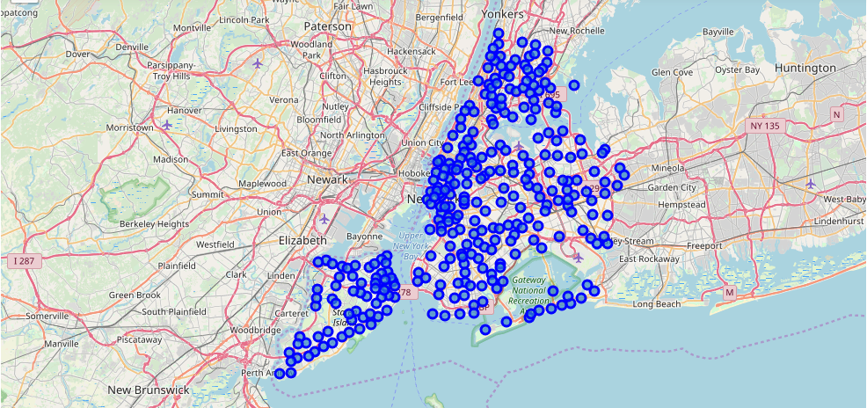
Create a map of New York with neighborhoods superimposed on top

Slide 7
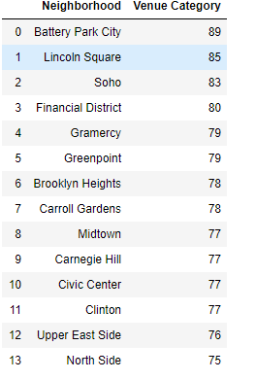
Explore and Get Result
Here showing resulted neighborhood where restaurant preferable. I select preferable place which are most surrounding with venue and define this whose listed value bigger then 75.

Slide 8
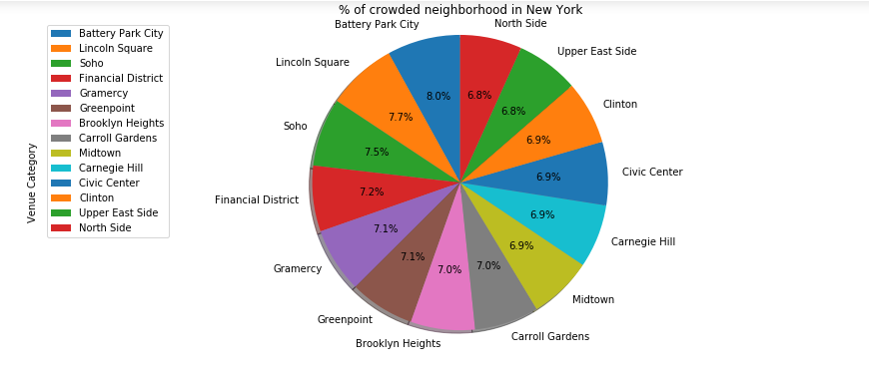
show the result with the visualization:

Slide 9
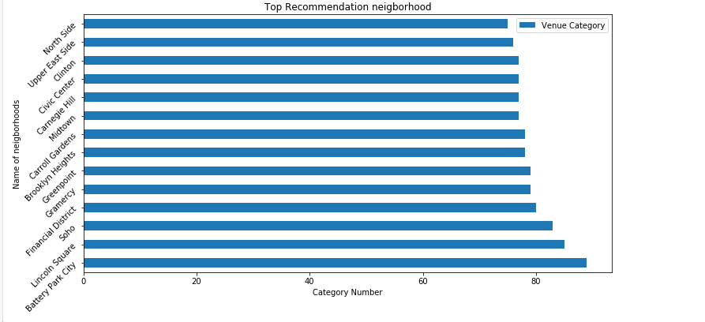
show the result with the visualization:

Slide 10
Thank you

